Slide 1
Coping with
Knee Pain
﻿First M. Last, MD 123 Main Street, Anywhere, MA
yourname@email.com | www.yourwebsite.com

Slide 2
Disclaimer
The content on the following slides is for information purposes only. This document has been provided as a framework for a patient education tool. It is not intended to be used as is, without the addition of medical information from a qualified healthcare professional, or aid of a certified doctor to provide guidance, qualified medical advice, opinions and additional information. The content is not intended to be used alone or as a substitute to professional medical advice, diagnosis or treatment. You should not rely solely on the information provided herein when making medical decisions, and any use of this information is solely at your own risk.
This document does not provide legal or compliance advice, and may need additional or different information to comply with the specific laws of your state. This information is not intended to be used outside the United States.
ConforMIS is not responsible for final presentation content or the addition of third-party materials, including but not limited to linked third-party videos, linked third-party sites, and other third-party content. ConforMIS does not control or endorse this third-party content and makes no representations regarding its accuracy. ConforMIS does not warrant this information in any way, either as is or as modified.
Advances in Imaging

Slide 3
Understanding Your Knee
Healthy Knee Anatomy
Osteoarthritis the Disease
Symptoms of Osteoarthritis of the Knee

Slide 4
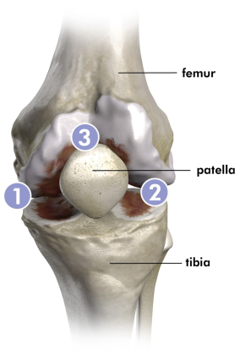
Healthy Knee Anatomy
UNDERSTANDING
YOUR KNEE
Your knee joint is formed by the intersection of the femur (thigh bone), the tibia (shin bone), and the patella (the knee cap). These bones form three “compartments” or sections.
Medial compartment (inner half of your knee)
Lateral compartment (outer half of your knee
Patella femoral compartment (behind the knee cap)
In a normal functioning knee, each bone glides smoothly against the other on a layer of cartilage that covers the ends of the bone. In a knee joint affected by osteoarthritis, the smooth cartilage lining on the inside of the joint has worn away. Your surgeon can determine the extent and severity of your OA.
Left Knee:
Osteoarthritis can affect one, two or all three compartments of the knee.

Slide 5
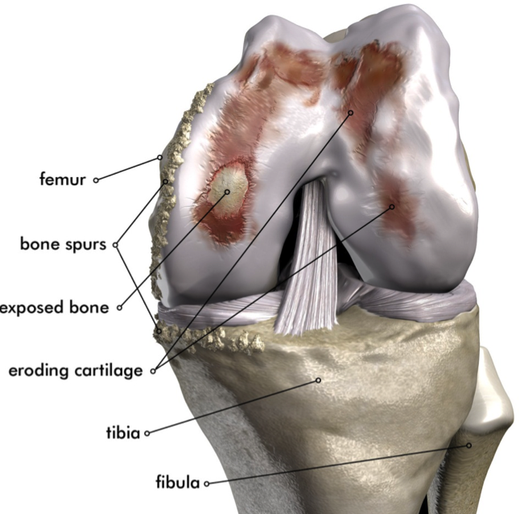
Osteoarthritis the Disease
UNDERSTANDING
YOUR KNEE
Osteoarthritis (OA) is the most common form of arthritis, affecting tens of millions of people worldwide.
It is a degenerative joint disease characterized by the breakdown and eventual loss of joint cartilage.
The breakdown and wearing away of cartilage causes the bones to rub together resulting in extreme pain.
OA resulting from “wear and tear” is the most common reason individuals need to undergo knee replacement surgery.

Slide 6
Symptoms of Osteoarthritis of the Knee
UNDERSTANDING
YOUR KNEE
Knee pain associated with:
Standing or walking short distances
Climbing up or down stairs
Sitting in or standing up out of chairs
Initial pain and/or stiffness with activities initiated from a sitting position
Stiffness in the knee after getting out of bed
A crunching sensation when the knee is used

Slide 7
Treatment Options
Medical Management
Knee Injections
Surgical Options
Joint Replacement

Slide 8
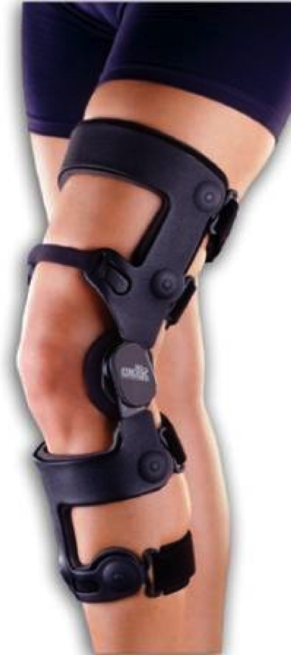
Medical Management
TREATMENT
OPTIONS
Health and behavior modification
Weight loss to help decrease stress on the joints
Exercise to help improve mobility
Physical therapy
Glucosamine drinks
Do they really work?
Tylenol / NSAIDs for pain management
Braces, canes and other assistive devices

Slide 9
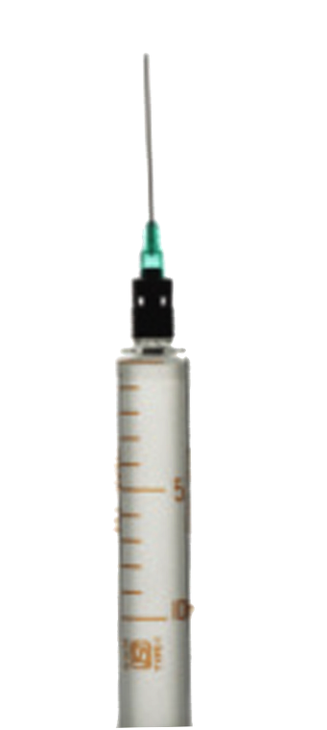
Knee Injections
TREATMENT
OPTIONS
Corticosteroid (anti-inflammatory) injections for temporary pain relief
Hyaluronic acid injections (viscosupplementation – “WD 40”)
Approved for 6 Month Relief
Processed from Rooster Combs
Single injection or multiple injection series

Slide 10
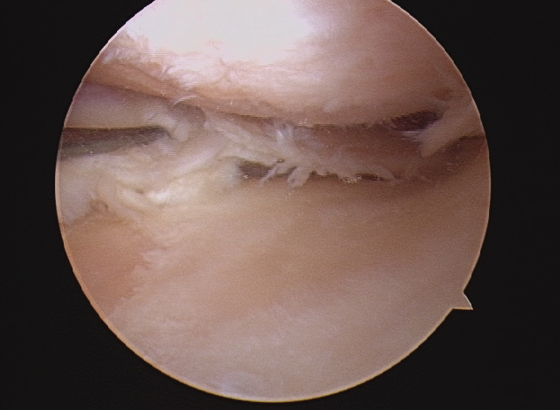
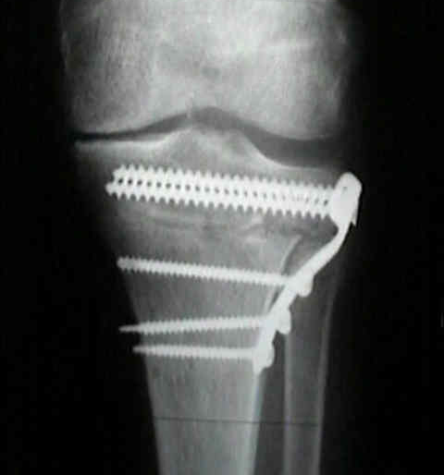
Surgical Options
TREATMENT
OPTIONS
Arthroscopic Procedures
Meniscus removal / repair
Debridement
Joint Realignment
HTO
Interpostional Device

Slide 11
Joint Replacement
TREATMENT
OPTIONS
About Joint Replacement
Who is a Candidate?
Tricompartmental Knee Arthroplasty
Unicompartmental Knee Arthroplasty
Bicompartmental Knee Arthroplasty
Potential Complications
What to Expect After Surgery

Slide 12
Joint Replacement
TREATMENT
OPTIONS
Joint replacement is a procedure in which parts of the diseased knee are replaced with an artificial joint
600,000 knee replacements done in U.S. each year
Traditional total knee replacement (TKR) is the gold standard solution for many decades
The majority of knee replacements performed today
Long-term clinical data available
New techniques, materials and designs have made it very successful surgery and a good option for many patients
Still a major surgery with accompanying surgical and implant performance risks, and significant rehabilitation commitment

Slide 13
Who is a Candidate for Joint Replacement?
TREATMENT
OPTIONS
Before joint replacement surgery is considered, all non-surgical options should be tried first
The best candidate is someone who has:
Daily pain that interferes with their normal activities
Significant knee stiffness
Instability, or buckling, of the knee
Significant deformity caused by osteoarthritis (bowlegs or knock-knees)

Slide 14
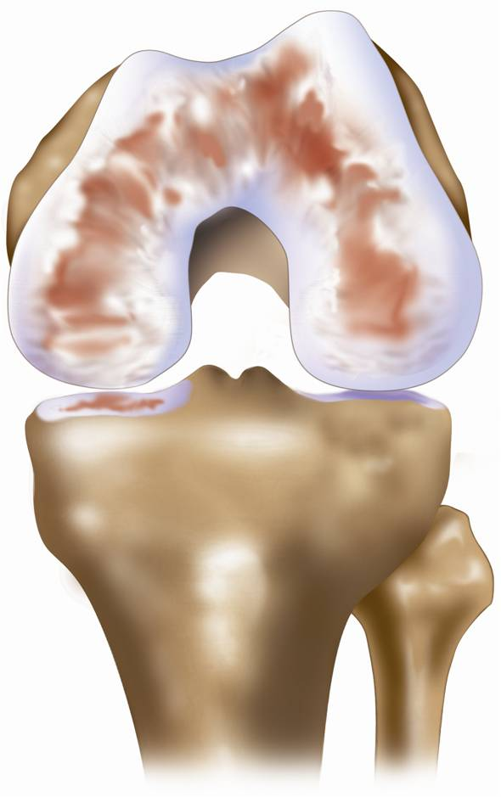
Joint Replacement: Total Knee Replacement
TREATMENT
OPTIONS
Tricompartmental Knee Replacement

Slide 15
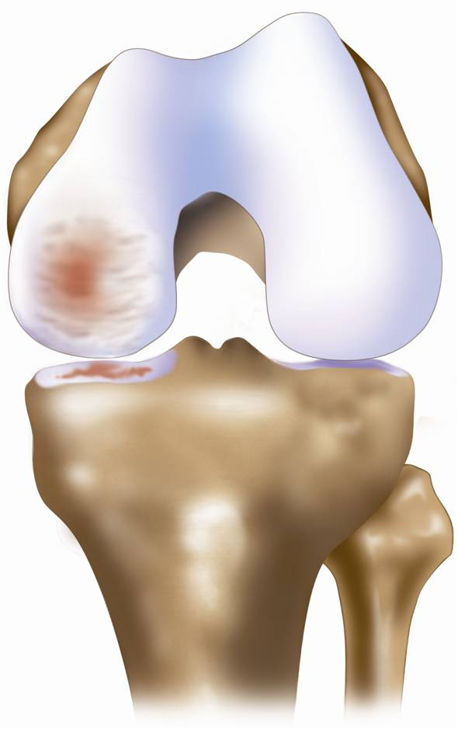
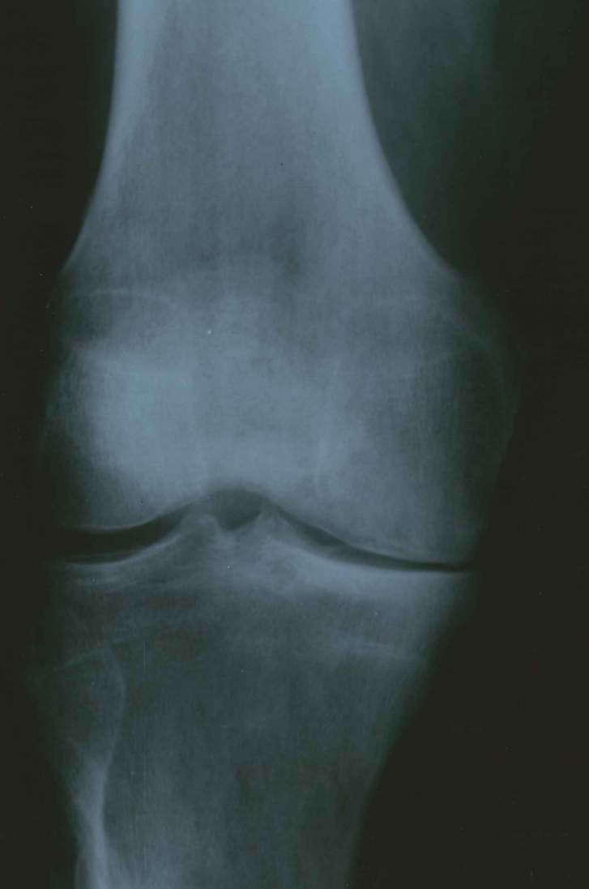
Joint Replacement: Partial Knee Replacement
TREATMENT
OPTIONS
Unicompartmental Knee Arthroplasty

Slide 16
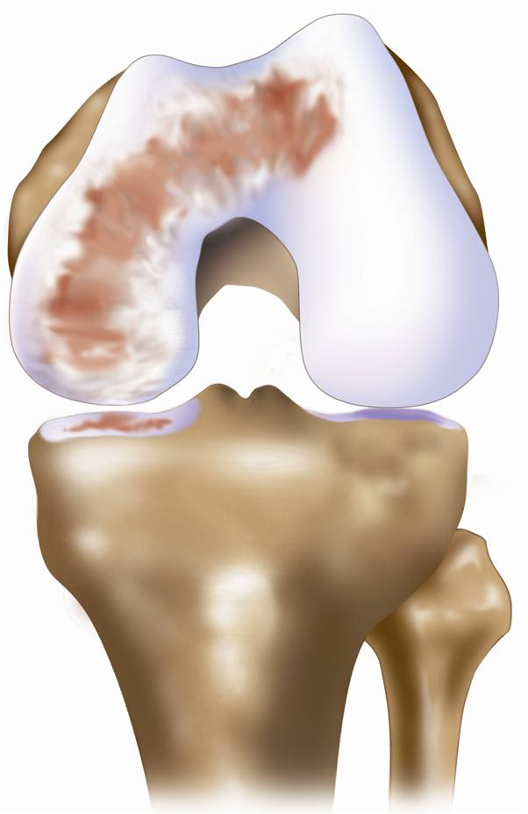
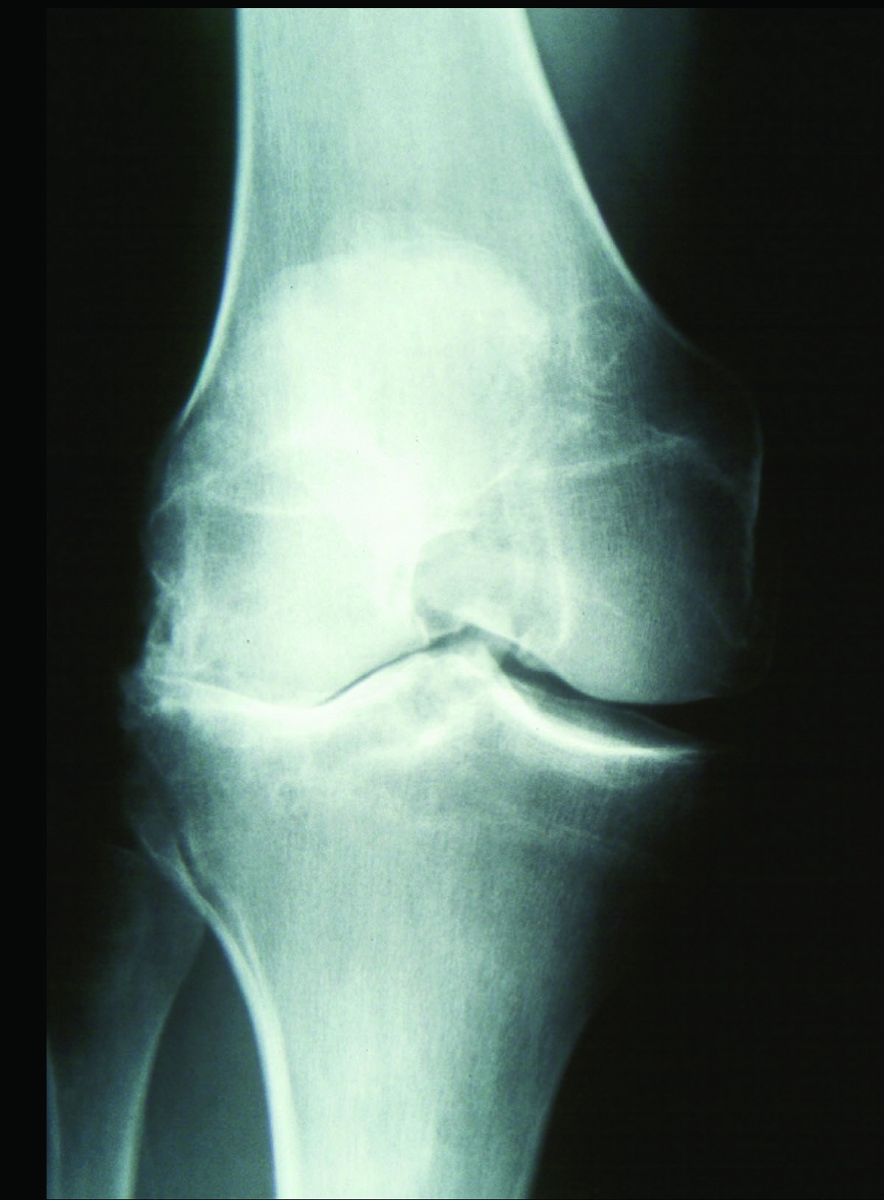
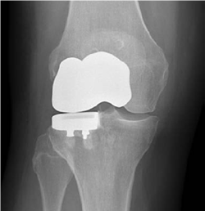
Joint Replacement: Partial Knee Replacement
TREATMENT
OPTIONS
Bicompartmental Knee Replacement

Slide 17
Joint Replacement
TREATMENT
OPTIONS
Potential Complications of any Joint Replacement
Surgical Complications
Infection
Blood Clots
Medical Complications
Knee Implant Complications
Loosening or subsidence
Polyethylene wear
Persistent pain

Slide 18
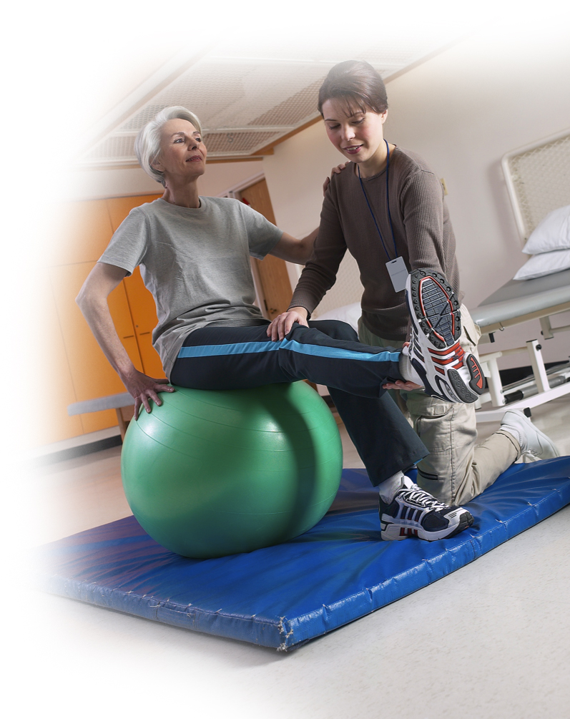
Joint Replacement
TREATMENT
OPTIONS
What to Expect After Surgery
A typical patient should expect:
You will be out of the hospital within 2 days and then begin your rehabilitation
You should be able to weight bear soon after surgery, and walk with an aid at discharge
Long-term results of knee surgery depend on your work in rehabilitation
By 6 weeks, you should be able to engage in many of your typical daily activities
More physical activities, such as sports may take 3 months to be able to do comfortably

Slide 19
ConforMIS Personalized Total Knee Implants
Traditional TKR Dissatisfaction
iTotal® Personalized Knee Implants
Designed to Fit Your Anatomy
Individualized Shape
Patient Experiences

Slide 20
Patients Have Reported Dissatisfaction with Traditional TKR
PATIENT-SPECIFIC KNEE IMPLANTS
1 in 5 patients are not satisfied with the results of their total knee replacement.¹
ConforMIS patient-specific implants are intended to address some of the leading causes of patient dissatisfaction.
Notes:
1. Bourne, et al; Patient Satisfaction after Total Knee Arthroplasty. Who is Satisfied and Who is Not? Clinical Orthopaedics and Related Research; 2010, 468: 57-63

Slide 21
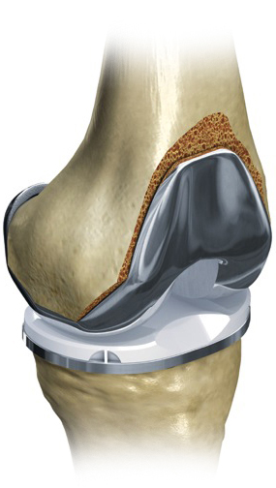
Leading Causes of Dissatisfaction
PATIENT-SPECIFIC KNEE IMPLANTS
Residual Pain due to improper fit and rotation
Functional Limitations due to altered kinematics and instability
Early Implant Failure due to poor alignment and polyethylene wear
Off-the-Shelf
knee implants can have painful overhang or underhang because they are not sized to fit each patient.

Slide 22
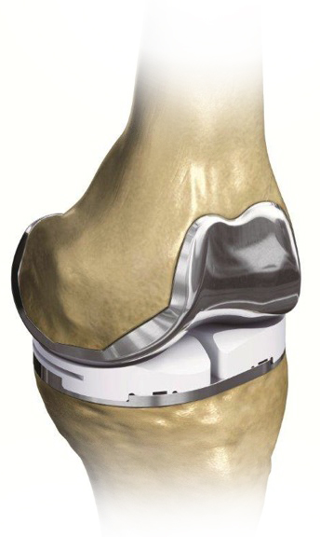
iTotal® G2 Total Knee Replacement System
PATIENT-SPECIFIC KNEE IMPLANTS
Designed to address some of the leading causes of patient dissatisfaction
Designed for each individual based on your anatomy
Customized fit and alignment avoids sizing compromises common with traditional off-the-shelf implants
Designed to follow the shape and contour of each patient’s knee to help restore natural kinematics
Designed for optimal bone preservation
Cost is similar to standard total knee and covered by many major insurance companies

Slide 23
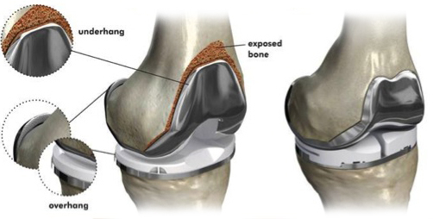
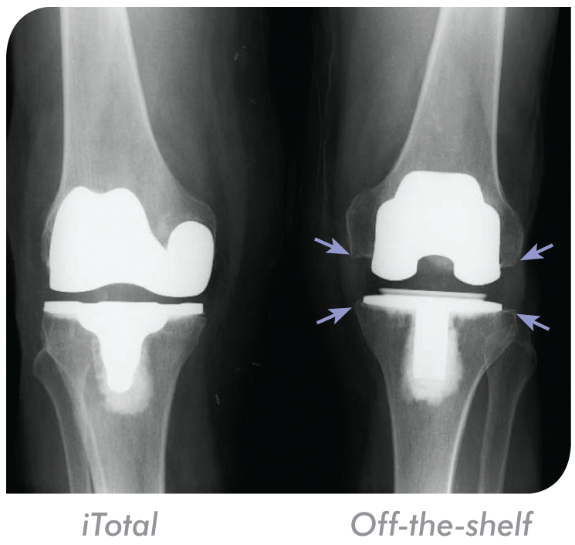
Individualized Implant Fit
PATIENT-SPECIFIC KNEE IMPLANTS
ConforMIS implants fit precisely by using CT scan data to design an implant made for each patient’s own knee.
Patient-specific design that virtually eliminates overhang
Customized fit for every patient
Off-the-Shelf TKR
iTotal G2
Patient-Specific
Implant

Slide 24
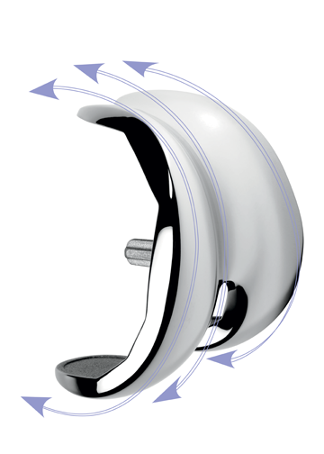
Individualized Implant Shape
PATIENT-SPECIFIC KNEE IMPLANTS
ConforMIS implants match the shape and curvature of a patient’s natural knee.
The iTotal has been shown to more closely approximate a patient’s normal range of motion
Provides each patient with the potential for a more natural feeling knee
Patient-specific shape
The iTotal G2 maintains the natural curvature of the patient’s knee.

Slide 25
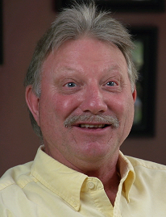
Patient Experiences with ConforMIS
PATIENT-SPECIFIC KNEE IMPLANTS
“I had one knee done with an off-the-shelf implant and it still hurts. I had the other knee done with ConforMIS and it’s a world of wonderful.”
- Alan Kiel
“ConforMIS made a big, big difference in my life. Now I’m able to do things that I’d stopped being able to do.”
- John Lynch, DVM

Slide 26
ConforMIS Personalized Partial Knee Implants
PKR Trends
Advantages & Disadvantages
iUni® G2
iDuo® G2

Slide 27
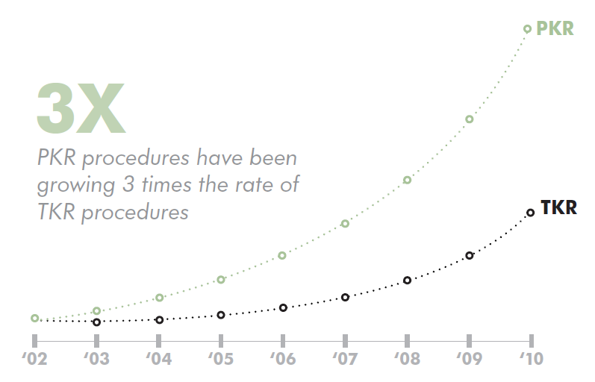
Not Everyone Needs a Total Knee
PARTIAL KNEE IMPLANT OPTIONS
As patients get younger and more active, the interest in bone and tissue sparing partial knee replacement (PKR) has increased dramatically.
More surgeons are recommending PKR
PKR is a less invasive option compared to traditional TKR
Higher patient satisfaction and better outcomes

Slide 28
Partial Knee Replacement
PARTIAL KNEE IMPLANT OPTIONS
20-40% of all TKRs are performed on people who could have been treated with a partial knee replacement
Patients tend to prefer UKA to TKA
Preserves the ACL and PCL
Preserves more bone and cartilage
Less invasive surgery, less blood loss
Smaller incision
Faster recovery
Disadvantage of partial knee replacement
Has historically shown higher revision risk
Potential for continued disease progression to other compartments

Slide 29
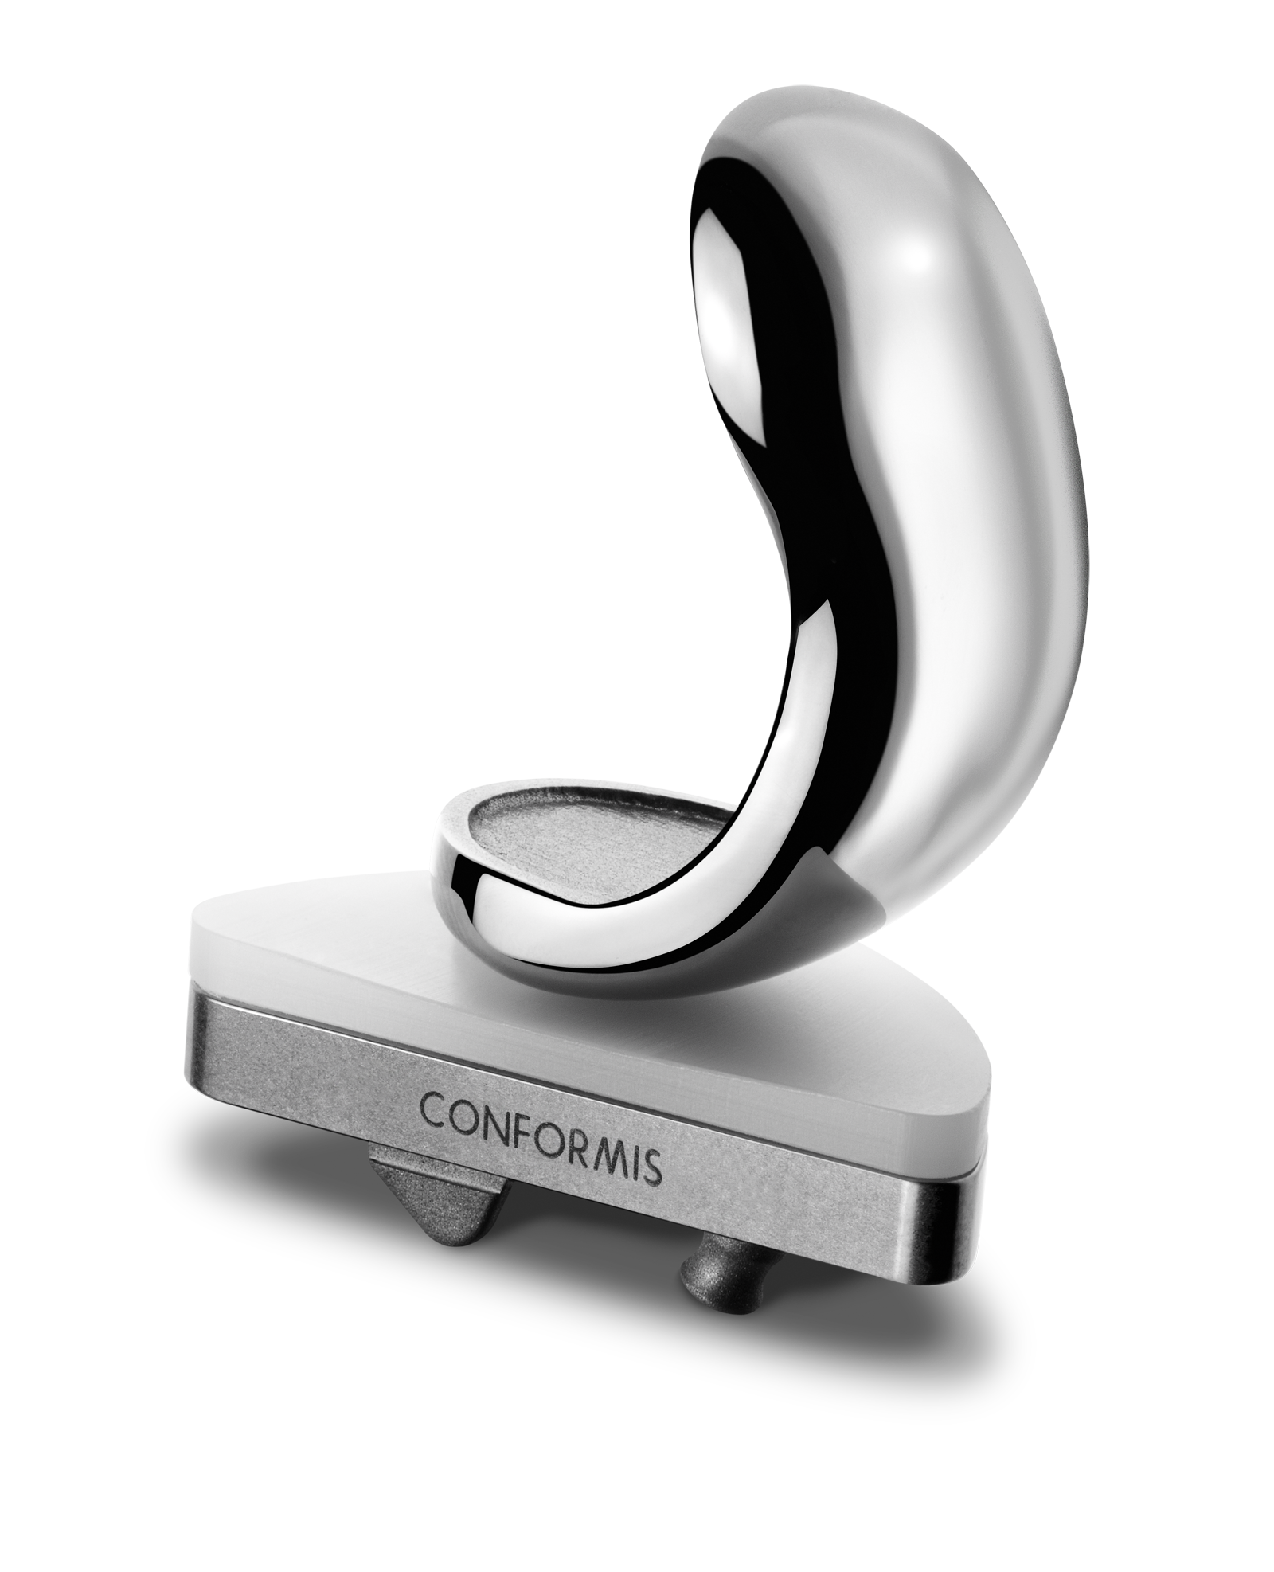
Unicompartmental Knee Replacement iUni® G2
PARTIAL KNEE IMPLANT OPTIONS
The only patient-specific unicompartmental knee replacement
Designed to treat medial or lateral tibiofemoral osteoarthritis
Provides a customized fit specific to your knee
Designed to mimic the natural shape of your knee to help retain more of your natural function
Allows for a less traumatic procedure and fewer bone cuts to preserve more of your natural knee for future treatment, if necessary

Slide 30
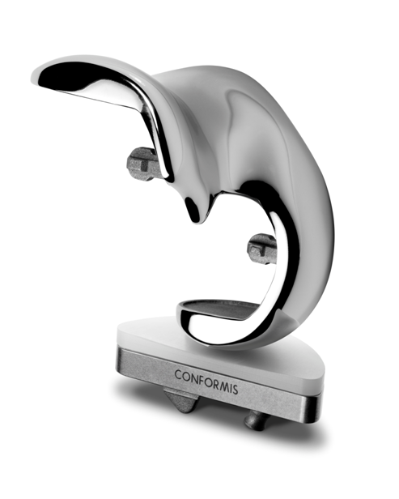
Bicompartmental Knee Replacement iDuo® G2
PARTIAL KNEE IMPLANT OPTIONS
A revolutionary alternative to traditional off-the-shelf TKR
Designed to treat medial or lateral tibiofemoral with patellofemoral osteoarthritis
Combines proven TKR principles for patellofemoral treatment with the advantages of the ConforMIS partial knee system
Treats just the affected knee compartments with a precise, patient-specific implant that delivers unparalleled fit, preserves all ligaments and conserves far more bone than traditional TKR

Slide 31
ConforMIS Patient-Specific Technologies
iFit® Image-to-Implant™ Technology
ConforMIS Process

Slide 32
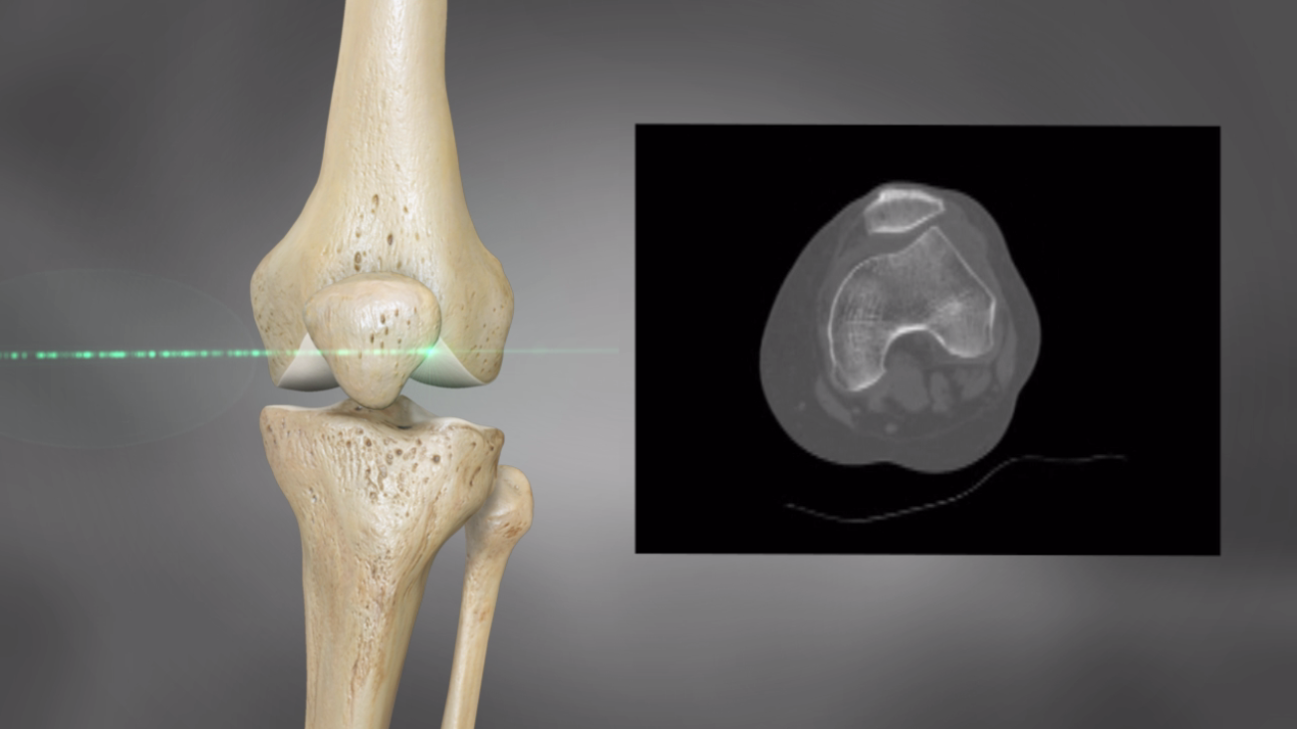
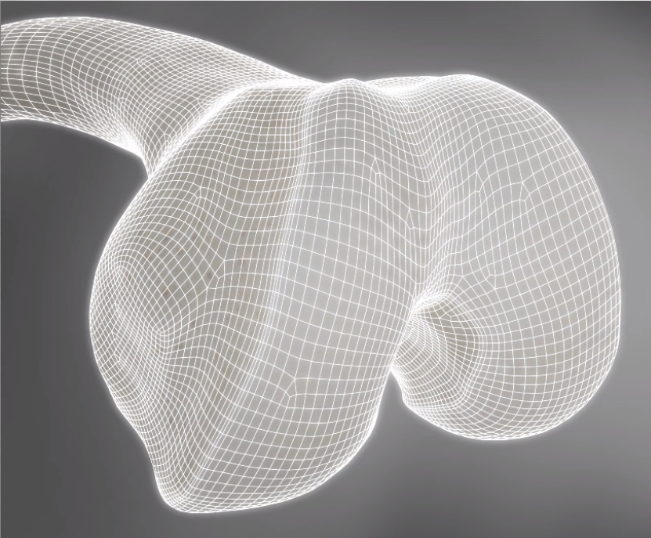
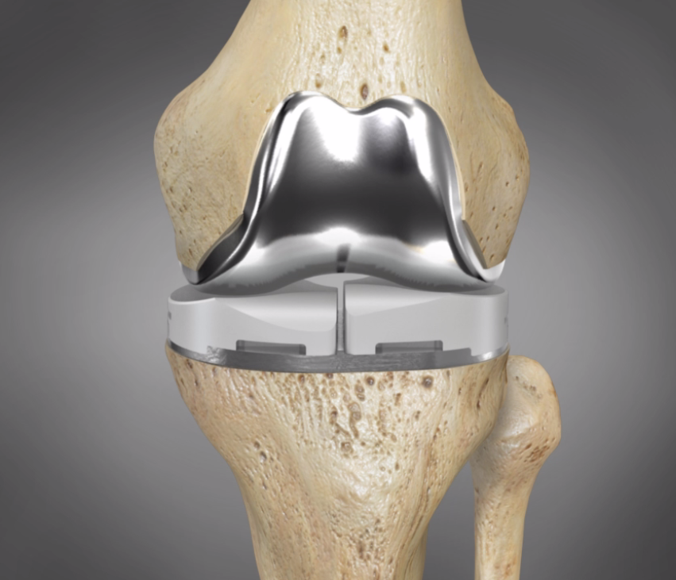
iFit® Image-to-Implant™ Technology
CONFORMIS
PATIENT-SPECIFIC
TECHNOLOGIES
Advances in Imaging
iFit video

Slide 33
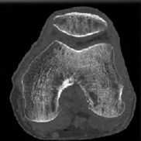
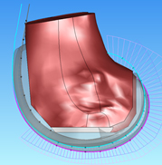
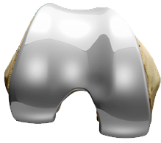
Personalization Process
PATIENT-SPECIFIC KNEE IMPLANTS
STEP 1: Scheduling a CT scan
___________________________________________________________________
Developing your personalized implant begins with images of your knee. Your doctor will give you a prescription to have a diagnostic scan at a nearby imaging center.
STEP 2: Getting your knee scanned
___________________________________________________________________
The imaging center will take a CT scan of your leg and send a diagnostic report to your surgeon for evaluation.
STEP 3: Recreating your knee
___________________________________________________________________
Using your CT scan, a computer generated 3-D virtual model of your knee is developed and will be used to individualize your implant for a personalized fit and correct alignment.
STEP 4: Personalizing the implant
___________________________________________________________________
Using a proprietary process, your implants are designed and manufactured for delivery in 6 weeks.
STEP 5: Preparing for surgery
___________________________________________________________________
Your implant will be delivered to your surgeon for the day of surgery. Speak to your surgeon about scheduling your surgery and what to expect.
STEP 6: Getting back on your feet
___________________________________________________________________
While every person’s experience is different, many people return to their daily activities within 6 weeks. More physical activities such as sports may take up to 3 months. Consult your doctor or physical therapist about your individual goals and limitations.

Slide 34
My ConforMIS Experience

Slide 35
Joint Replacement: ConforMIS
TREATMENT
OPTIONS
My Experience
XXXXXX
yyyyyyyyyyy
yyyyyyyyyyy
XXXXXX
yyyyyyyyyyy
yyyyyyyyyyy
XXXXXX
yyyyyyyyyyy
yyyyyyyyyyy
Slide is a placeholder to insert your own x-rays and commentary on TKR

Slide 36
Advances in Imaging
Thank You.
Questions?

